Slide 1

Exploring Neutrino Oscillations in KM3NeT
Begad Elhouty
Course Project for Theoretical Astroparticle Physics
26 Nov 2025

Slide 2
Agenda
1
History of Neutrinos
2
Neutrino Interactions & Types
3
Pivotal Neutrino Experiments
4
Mass Order Hierarchy
5
The KM3NeT Experiment
6
Broader Physics Research
26. 11. 2025
Exploring Neutrino Oscillations in KM3NeT

Slide 3
Neutrino History
26. 11. 2025
Exploring Neutrino Oscillations in KM3NeT

Slide 4
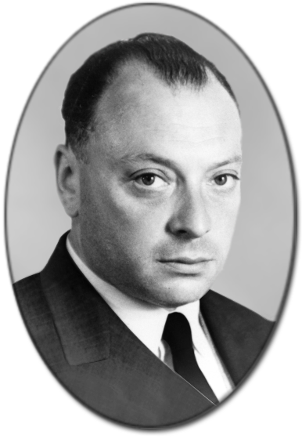

Neutrino History
1930 — Pauli proposes a neutral, nearly undetectable particle to restore energy–momentum conservation in beta decay.
1933 — Fermi develops the theory and names it the “neutrino” (“little neutral one”).
1956 — Reines & Cowan detect antineutrinos via inverse beta decay, confirming the particle’s existence.
Since then — Extensive progress on neutrino properties and interactions.
Ongoing — Key open questions about neutrinos’ place in the Standard Model and their broader role in physics.
Wolfgang Pauli (1900-1958)
26. 11. 2025
Exploring Neutrino Oscillations in KM3NeT

Slide 5
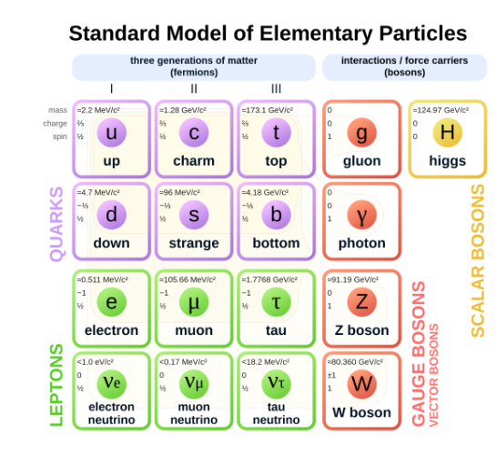
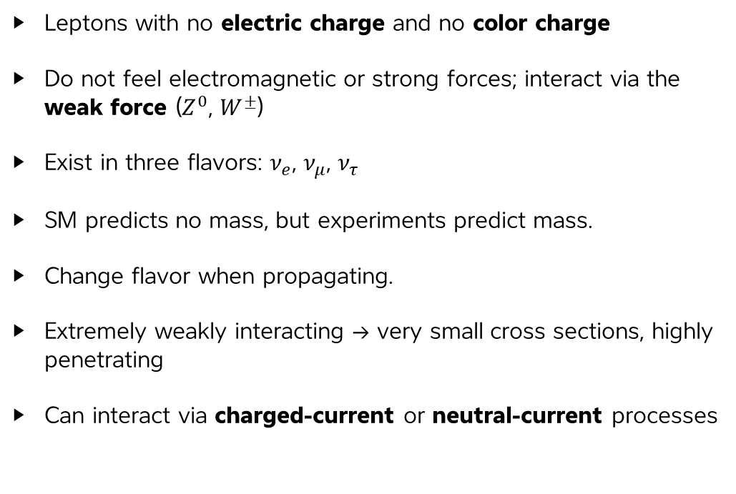
Neutrino’s Place in the Standard Model
Leptons with no electric charge and no color charge
Do not feel electromagnetic or strong forces; interact via the weak force ($Z^{0}$, $W^{±}$)
Exist in three flavors: $ν_{e}$, $ν_{μ}$, $ν_{τ}$
SM predicts no mass, but experiments predict mass.
Change flavor when propagating.
Extremely weakly interacting → very small cross sections, highly penetrating
Can interact via charged-current or neutral-current processes
26. 11. 2025
Exploring Neutrino Oscillations in KM3NeT

Slide 6
Neutrino Interactions & Types
26. 11. 2025
Exploring Neutrino Oscillations in KM3NeT

Slide 7
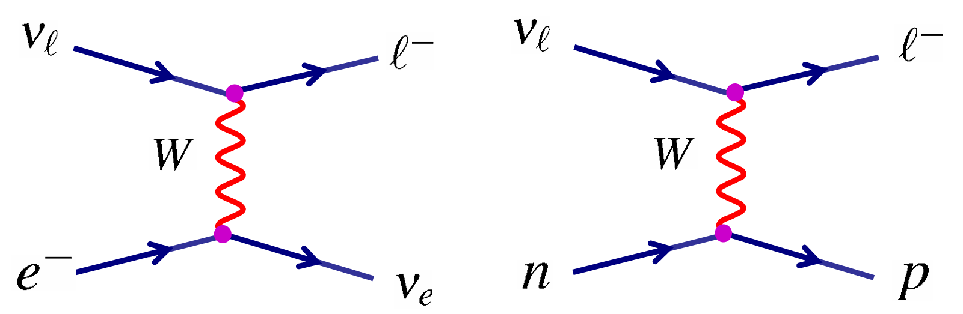
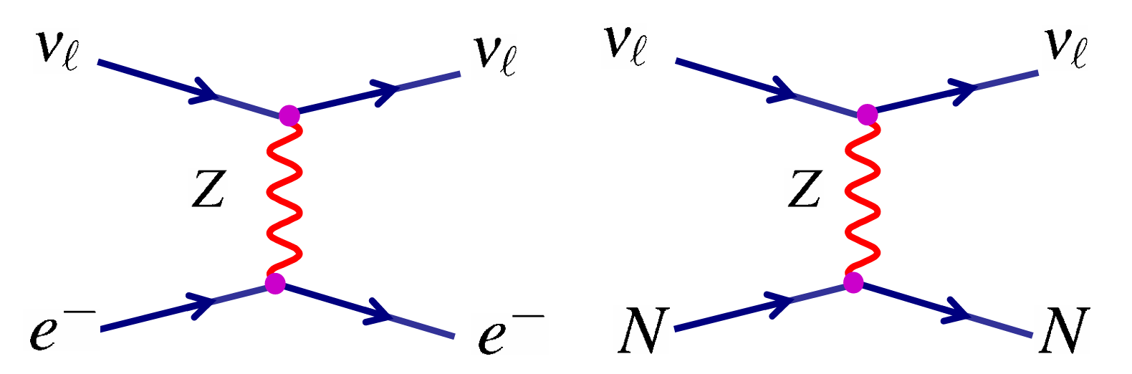
Neutrino Interactions
Neutrinos interact with matter via the weak interaction in 2 process.
Charged Current
Neutral Current
Leptons formed from neutrino flavor
Energy transfers from neutrino to electron/nucleon
Adapted from [Mark T. 2009]
26. 11. 2025
Exploring Neutrino Oscillations in KM3NeT

Slide 8
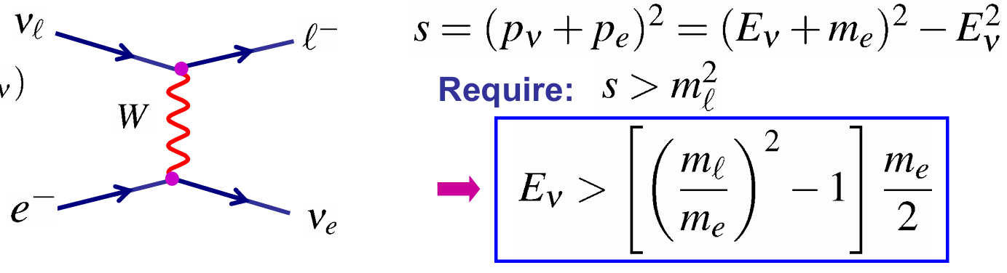
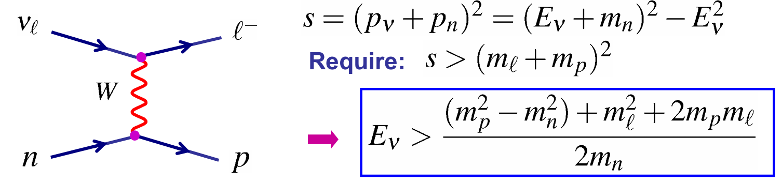
Neutrino Interactions Threshold
Neutrino detection depend on neutrino energy & flavour.
Neutrinos may not interact with matter if they have low energies (i.e. do not pass $E_{th}$).
CC Interaction on electrons
CC Interaction on nucleons
CC interactions are of most importance since they produce charged leptons we can detect!
Adapted from [Mark T. 2009]
26. 11. 2025
Exploring Neutrino Oscillations in KM3NeT

Slide 9
Neutrino Interactions Threshold
Neutrino detection depend on neutrino energy & flavour.
Neutrinos may not interact with matter if they have low energies (i.e. do not pass $E_{th}$).
CC Interaction on electrons
CC Interaction on nucleons
Solar $ν_{e}$ ($\sim$1 MeV) “disappear” when oscillating to $ν_{μ}$ or $ν_{τ}$
Atmospheric $ν_{μ}$ ($\sim$1 GeV) “disappear” when oscillating to $ν_{τ}$
Adapted from [Mark T. 2009]
26. 11. 2025
Exploring Neutrino Oscillations in KM3NeT

Slide 10
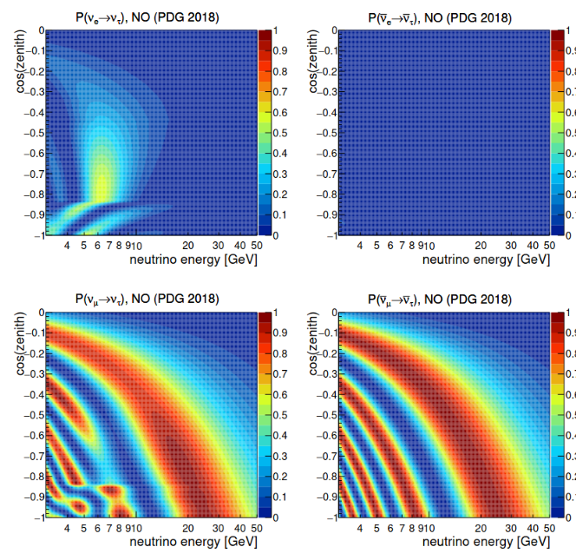
Atmospheric Neutrino Oscillations
Adapted from [Steffan H. 2021]
26. 11. 2025
Exploring Neutrino Oscillations in KM3NeT

Slide 11
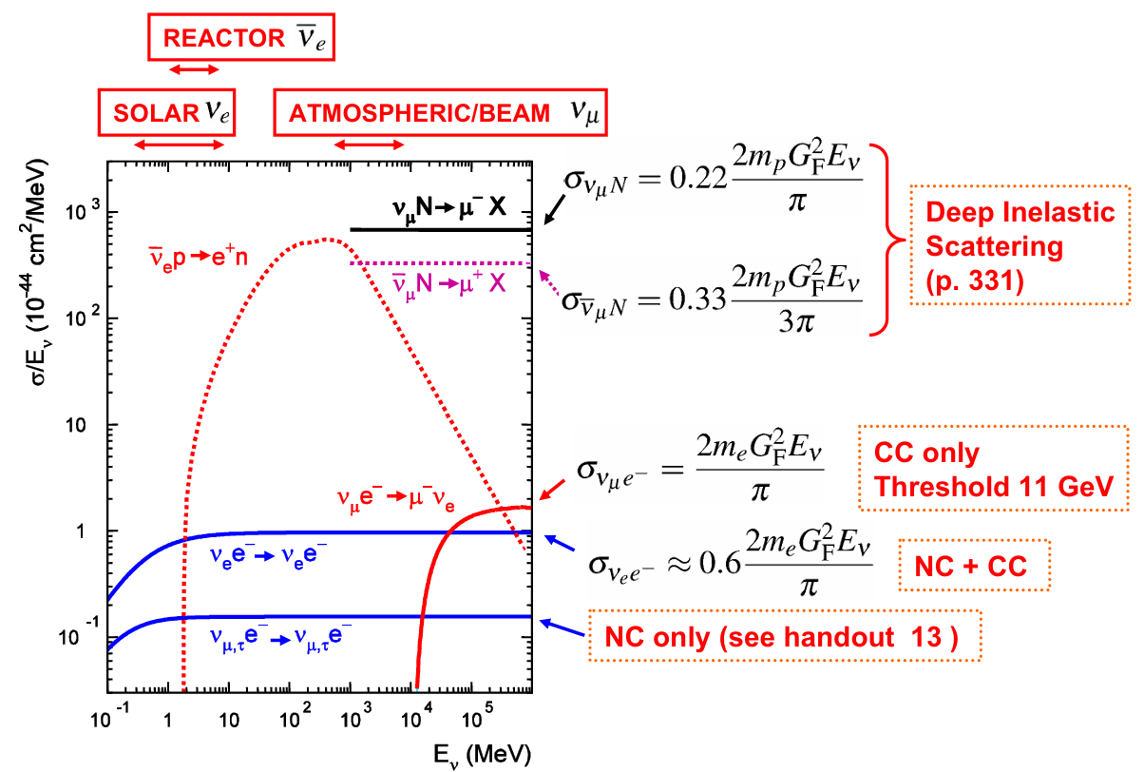
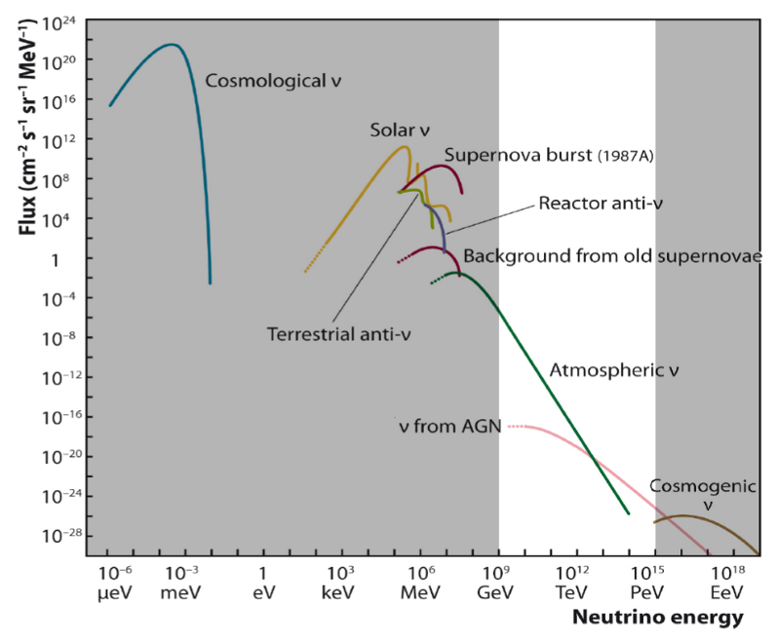
Neutrino Detection
Neutrino detection depends on energy & type.
Crossections of Neutrino Interactions
Energy & Flux of Neutrino Types
26. 11. 2025
Exploring Neutrino Oscillations in KM3NeT

Slide 12
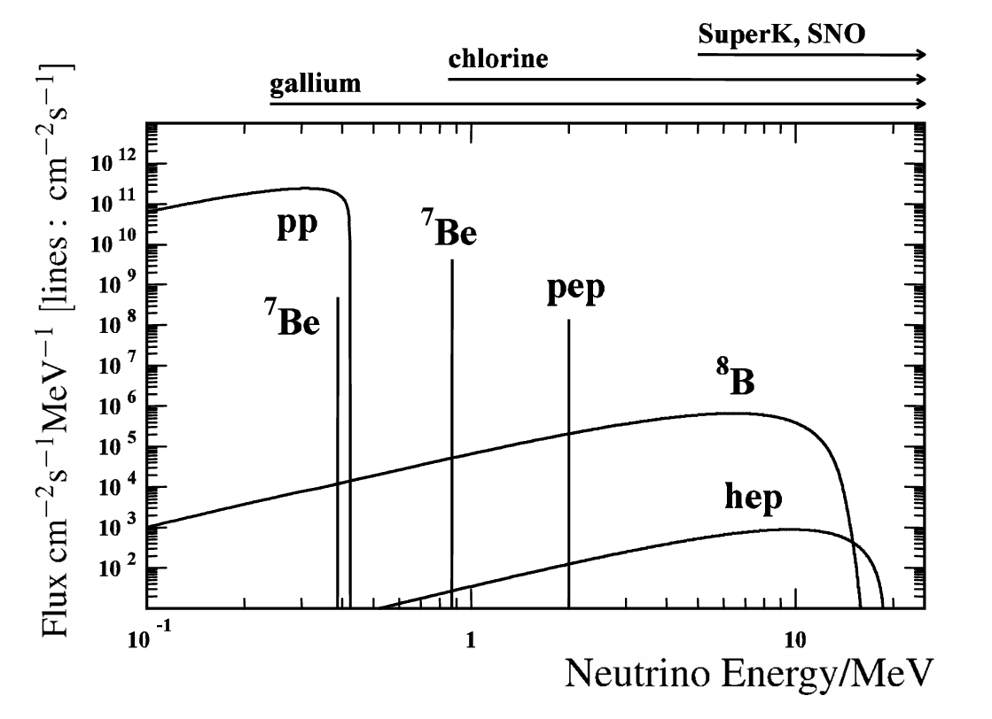
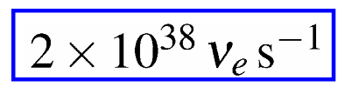
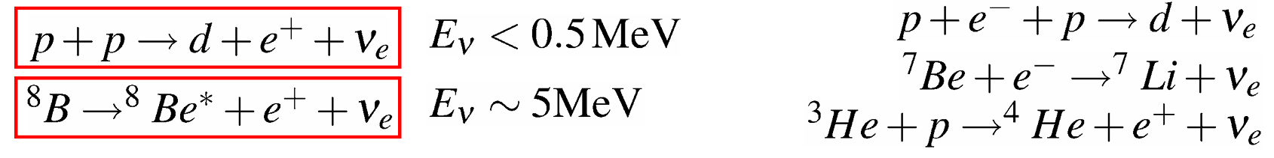
Solar Neutrinos
The Sun produces a large flux of electron neutrinos.
Many different nuclear reactions lead to a complex neutrino energy spectrum.
Experiments saw a deficit electron neutrino flux than theorized – The Solar Neutrino Problem
Adapted from [Mark T. 2009]
26. 11. 2025
Exploring Neutrino Oscillations in KM3NeT

Slide 13
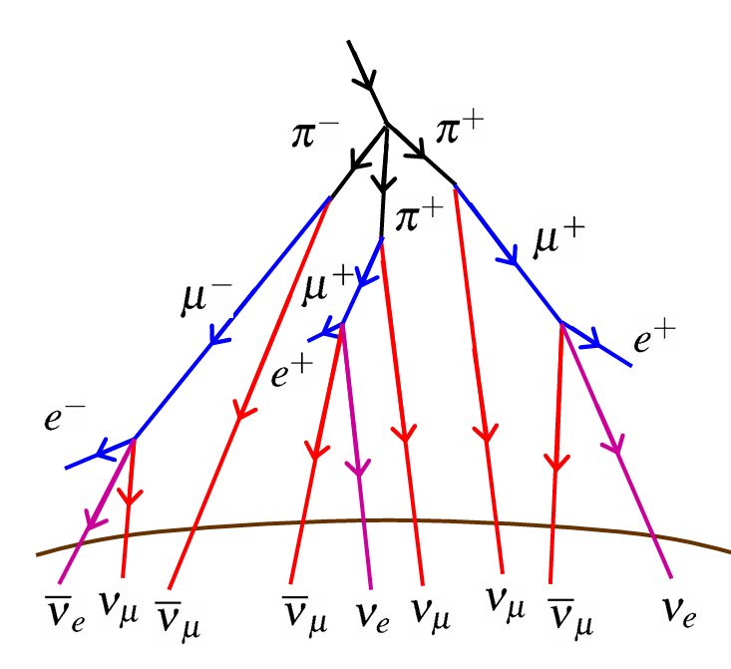
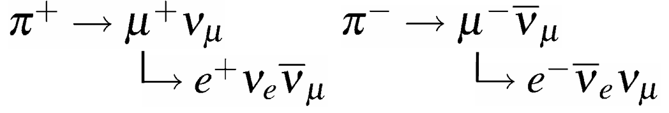

Atmospheric Neutrinos
High Energy Cosmic Rays (up to 10²⁰ eV) interact in the upper part of the Earth’s atmosphere.
Cosmic Rays are mostly made of ($\sim$86% protons, $\sim$11% helium, $\sim$1% heavier nuclei, $\sim$2% electrons)
Neutrinos are mainly produced from
Neutrino Energy: $E_{ν} \sim$ 1 GeV
Expected Flavor:
Adapted from [Mark T. 2009]
26. 11. 2025
Exploring Neutrino Oscillations in KM3NeT

Slide 14
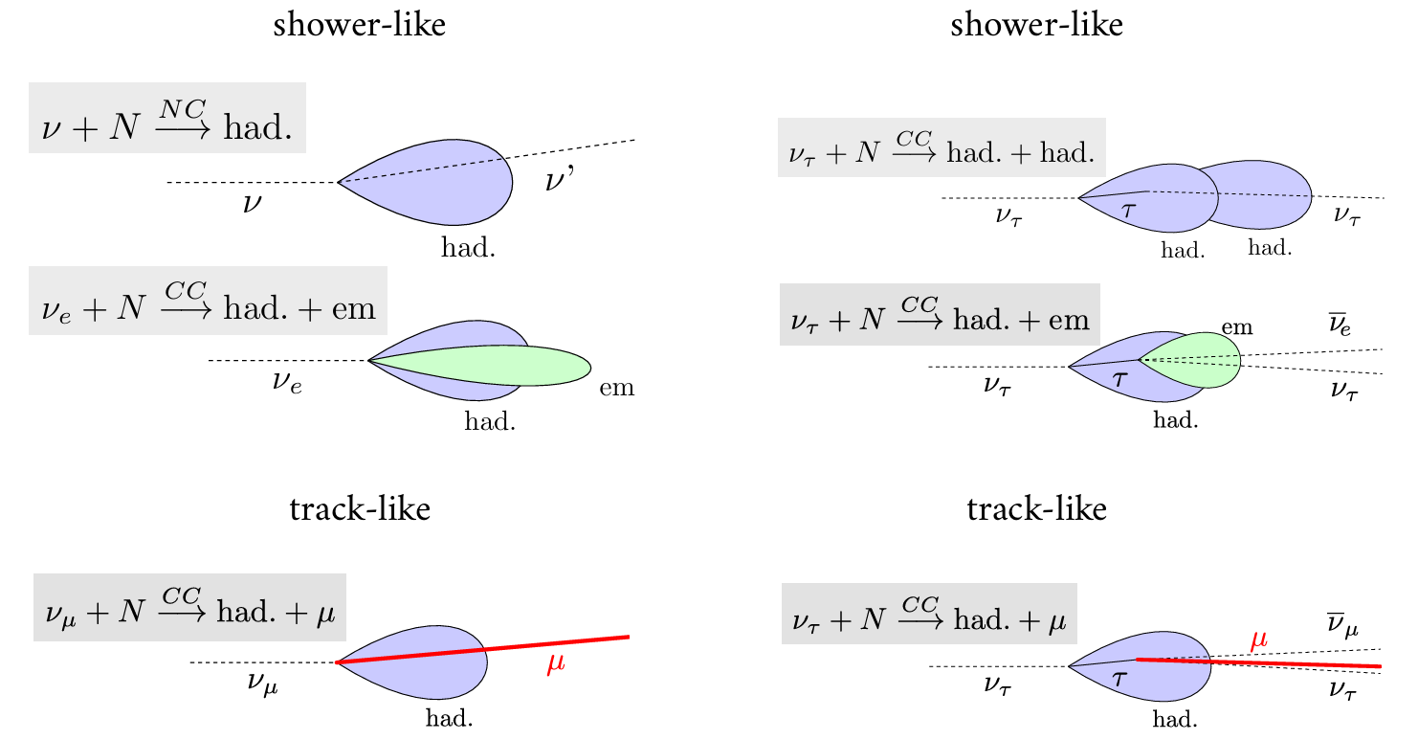
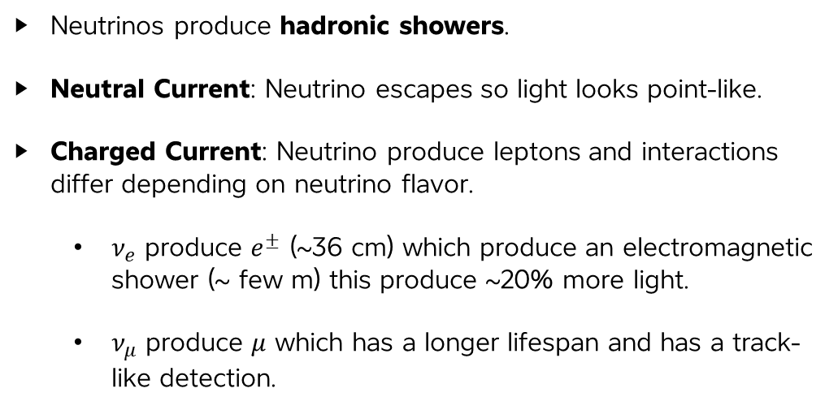
Neutrino Event Topologies
Neutrinos produce hadronic showers.
Neutral Current: Neutrino escapes so light looks point-like.
Charged Current: Neutrino produce leptons and interactions differ depending on neutrino flavor.
  $ν_{e}$ produce $e^{±}$ (~36 cm) which produce an electromagnetic shower (~ few m) this produce ~20% more light.
  $ν_{μ}$ produce $μ$ which has a longer lifespan and has a track-like detection.
Adapted from [Steffan H. 2021]
26. 11. 2025
Exploring Neutrino Oscillations in KM3NeT

Slide 15
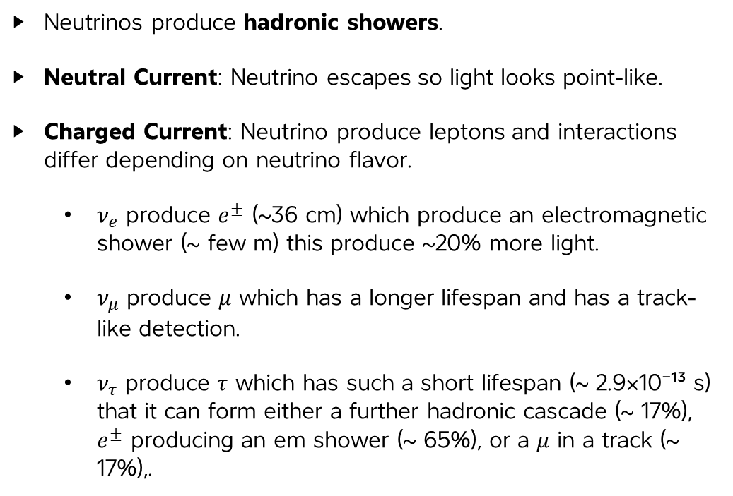
Neutrino Event Topologies
Neutrinos produce hadronic showers.
Neutral Current: Neutrino escapes so light looks point-like.
Charged Current: Neutrino produce leptons and interactions differ depending on neutrino flavor.
  $ν_{e}$ produce $e^{±}$ (~36 cm) which produce an electromagnetic shower (~ few m) this produce ~20% more light.
  $ν_{μ}$ produce $μ$ which has a longer lifespan and has a track-like detection.
  $ν_{τ}$ produce $τ$ which has such a short lifespan (~ 2.9×10⁻¹³ s) that it can form either a further hadronic cascade (~ 17%), $e^{±}$ producing an em shower (~ 65%), or a $μ$ in a track (~ 17%),.
Adapted from [Steffan H. 2021]
26. 11. 2025
Exploring Neutrino Oscillations in KM3NeT

Slide 16
Pivotal Neutrino Experiments
26. 11. 2025
Exploring Neutrino Oscillations in KM3NeT

Slide 17
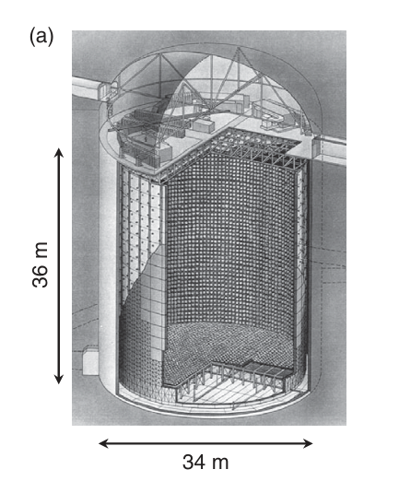
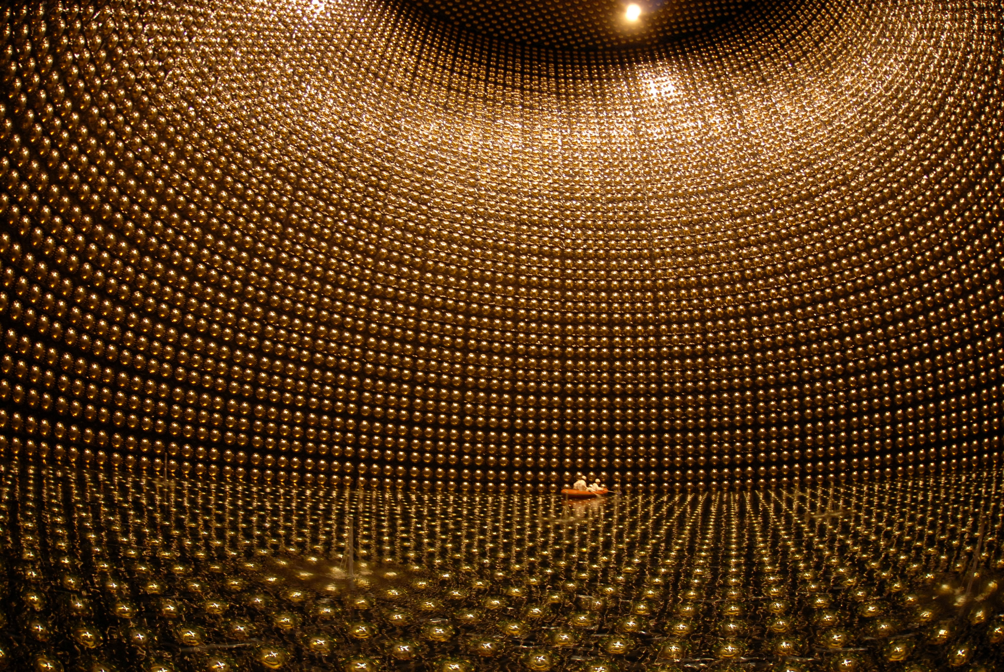
Super Kamiokande Experiment
50,000-ton water Cherenkov detector (∼36 m × 34 m)
Lined with 11,146 PMTs that can see single photons.
Deep underground to filter cosmic rays from atmosphere.
Adapted from [Mark T. 2009]
26. 11. 2025
Exploring Neutrino Oscillations in KM3NeT

Slide 18
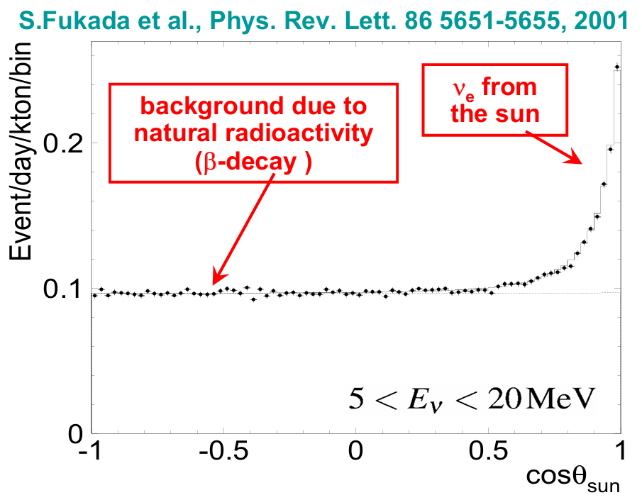
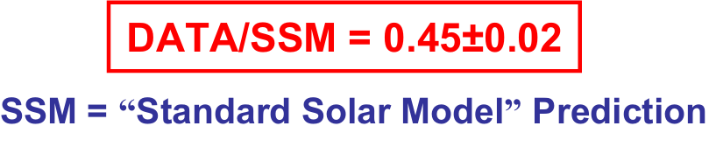
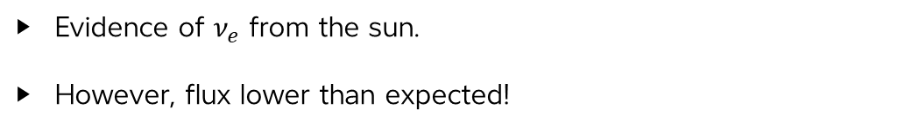
Super Kamiokande Experiment
Evidence of $ν_{e}$ from the sun.
However, flux lower than expected!
Adapted from [Mark T. 2009]
26. 11. 2025
Exploring Neutrino Oscillations in KM3NeT

Slide 19
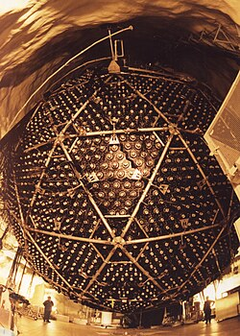
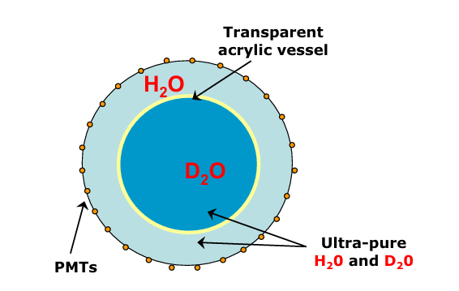
Sadbury Neutrino Observatory (SNO)
SNO is a deep mine in Ontario, Canada.
Main objective to detect solar neutrinos.
Recipients of the 2015 Nobel prize for confirming evidence of neutrino oscillations with super Kamiokande team.
Adapted from [Mark T. 2009]
26. 11. 2025
Exploring Neutrino Oscillations in KM3NeT

Slide 20
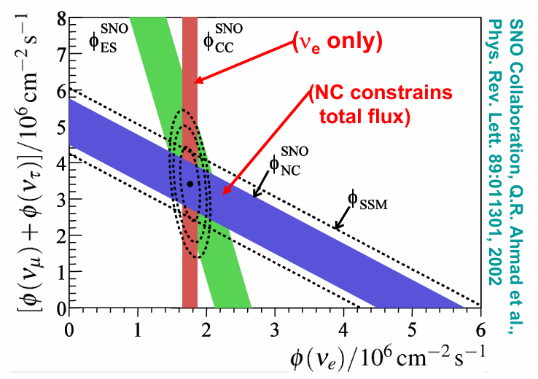
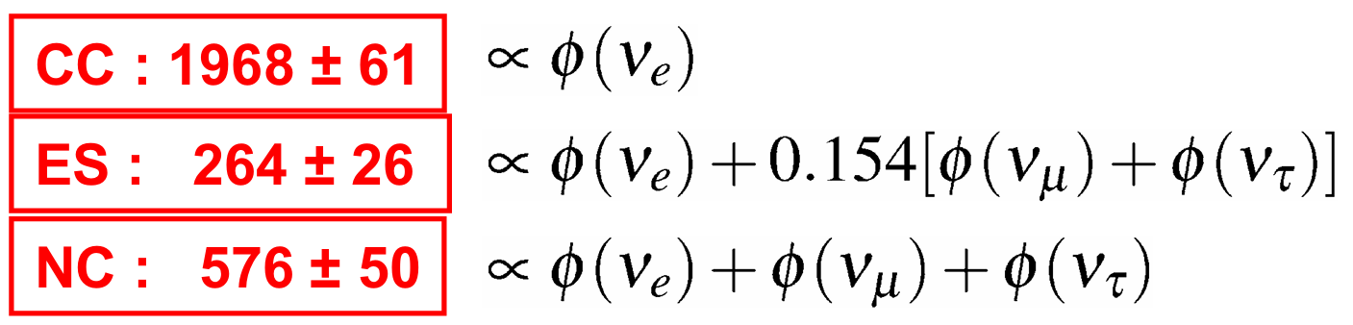
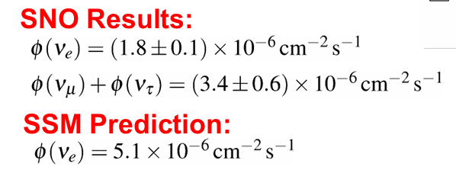
Sadbury Neutrino Observatory (SNO)
Different interactions measure different neutrino flavour fluxes.
Evidence of neutrino flux from $ν_{μ}$ and $ν_{τ}$ from the sun ⇒ neutrino oscillation!
Adapted from [Mark T. 2009]
26. 11. 2025
Exploring Neutrino Oscillations in KM3NeT

Slide 21
Neutrino Mass Hierarchy
26. 11. 2025
Exploring Neutrino Oscillations in KM3NeT

Slide 22
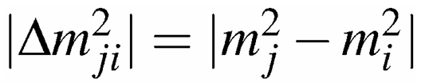
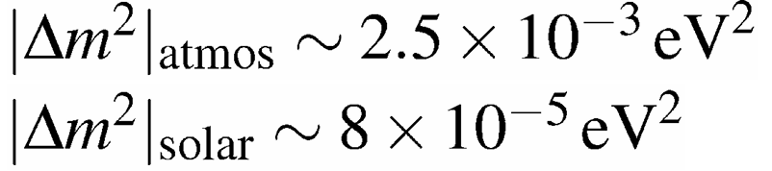
Neutrino Masses
Neutrinos were speculated to have no mass by SM.
However, neutrino oscillations require non-zero mass neutrinos.
We can only measure the mass limits.
Neutrino experiments can only determine:
  Atmospheric neutrino oscillations:
  Solar neutrino oscillations
26. 11. 2025
Exploring Neutrino Oscillations in KM3NeT

Slide 23
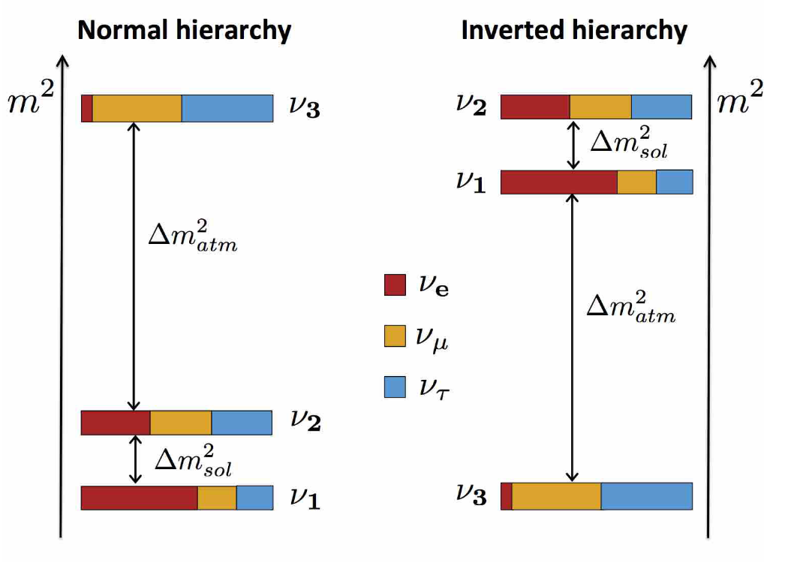
Mass Order Hierarchy
26. 11. 2025
Exploring Neutrino Oscillations in KM3NeT

Slide 24
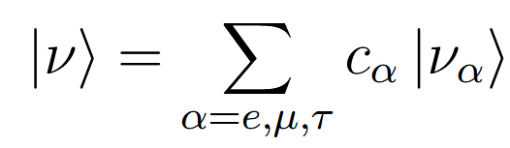
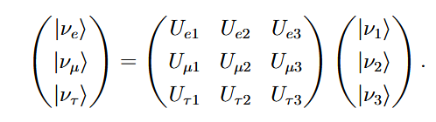

Neutrino States
A neutrino state can be written as a linear combination of its flavor or mass states.
There must be a matrix transformation that takes you from the flavor basis to the mass basis.
This transformation is called the PMNS matrix (Pontecorvo-Maki-Nakagawa-Sakata) and must be unitary to conserve probability.
26. 11. 2025
Exploring Neutrino Oscillations in KM3NeT

Slide 25
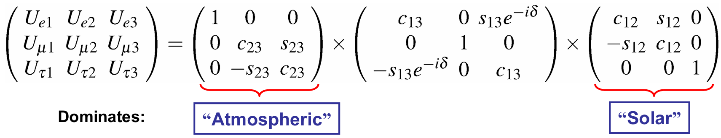
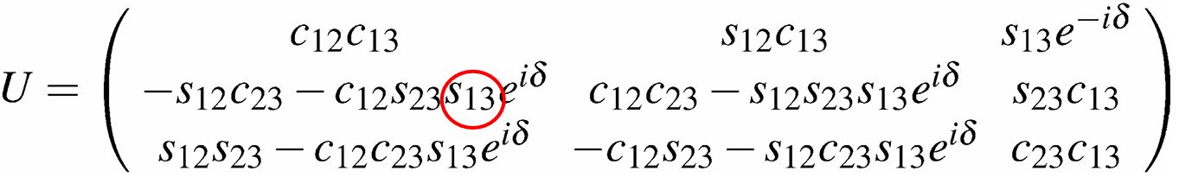
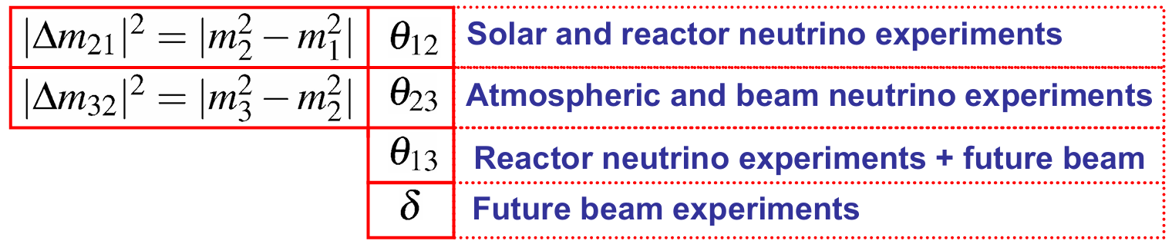
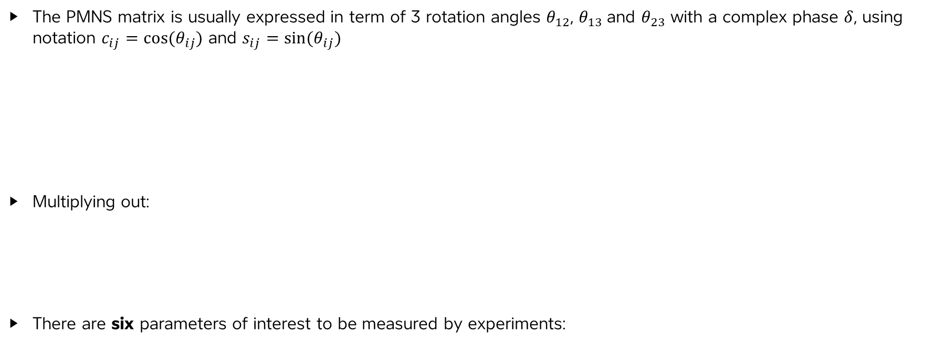
PMNS Matrix
The PMNS matrix is usually expressed in term of 3 rotation angles $θ_{12}$, $θ_{13}$and $θ_{23}$ with a complex phase $δ$, using notation $c_{ij}=cos⁡(θ_{ij})$ and $s_{ij}=sin⁡(θ_{ij})$
Multiplying out:
There are six parameters of interest to be measured by experiments:
26. 11. 2025
Exploring Neutrino Oscillations in KM3NeT

Slide 26

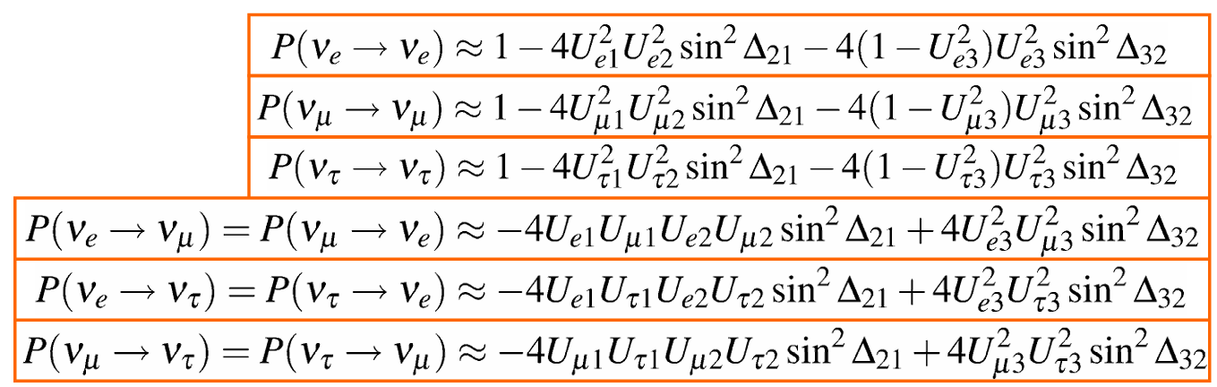
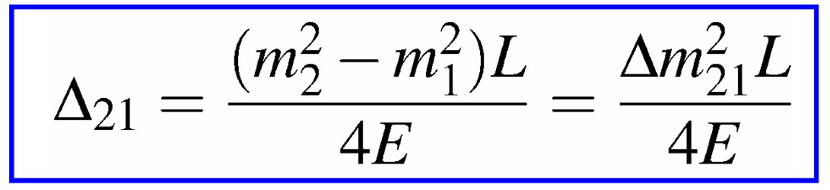



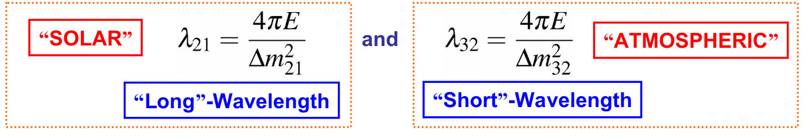
Neutrino Oscillation Probability
Through solving the unitary conditions, taking the PMNS matrix to be real and making approximations of
One can show that:
The wavelengths associated with and are:
26. 11. 2025
Exploring Neutrino Oscillations in KM3NeT

Slide 27
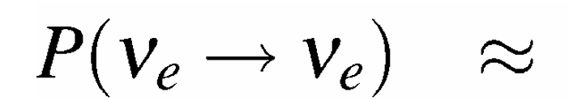
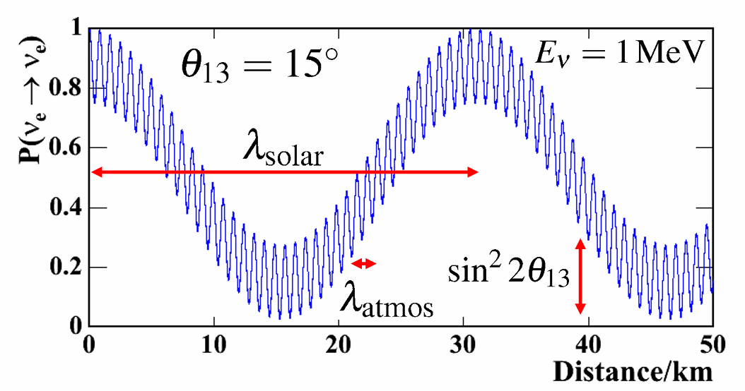
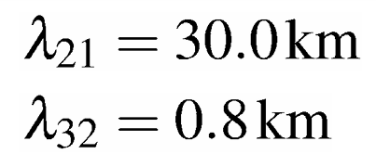
Electron Neutrino Survival Probability
We can now substitute in the values of the PMNS matrix $U_{e1}$, $U_{e2}$, $U_{e3}$ in the electron neutrino survival probability get the equation:
The mixing angles and phase differences can be approximated by experiments.
For 1 MeV neutrino:
26. 11. 2025
Exploring Neutrino Oscillations in KM3NeT

Slide 28
The KM3NeT Collaboration
26. 11. 2025
Exploring Neutrino Oscillations in KM3NeT

Slide 29
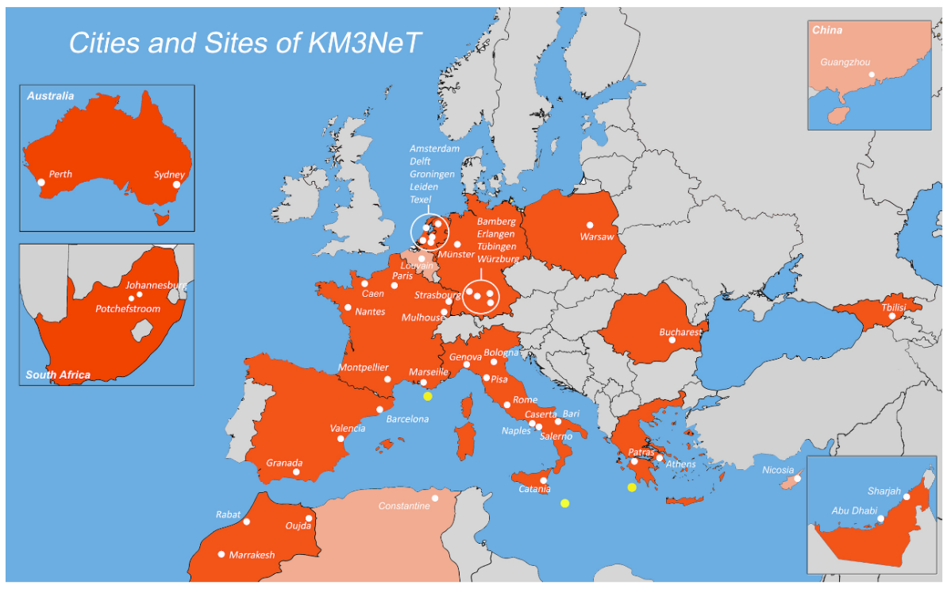
KM3NeT Experiment
International Collaboration with:
~ 250 members
45 partner institutions
Over 14 countries
Two detectors at different locations with different focus:
ARCA: Astroparticle Research with Cosmics in the Abyss
ORCA: Oscillation Research with Cosmics in the Abyss
Adapted from [KM3NeT 2016]
26. 11. 2025
Exploring Neutrino Oscillations in KM3NeT

Slide 30
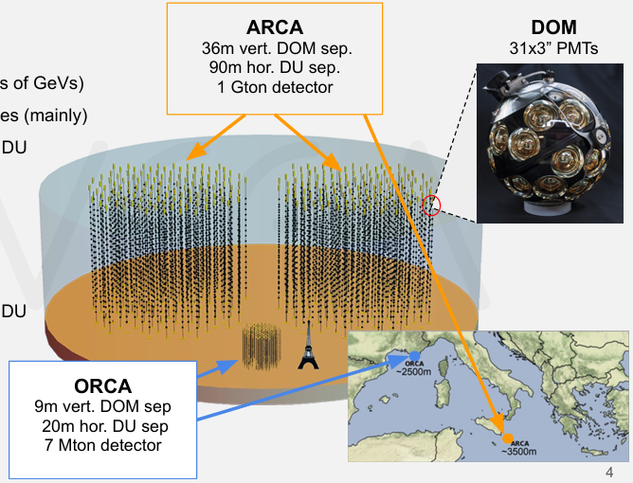



KM3NeT Experiment
KM3NeT/ORCA:
Low energies (few GeV to 10² GeVs)
Fundamental neutrino property studies
Full ARCA: 115 DUs, 18 DOMs per DU
Current ARCA: 23 DUs deployed
KM3NeT/ARCA:
High energies (sub-TeV to a few PeV)
Astrophysical studies
Full ARCA: 230 DUs, 18 DOMs per DU
Current ARCA: 28 DUs deployed
Adapted from [Jorge G. 2024]
26. 11. 2025
Exploring Neutrino Oscillations in KM3NeT

Slide 31
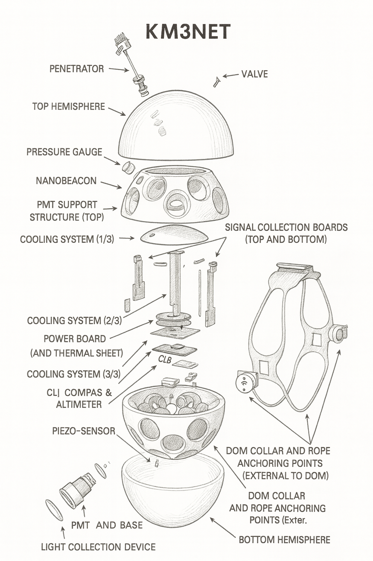
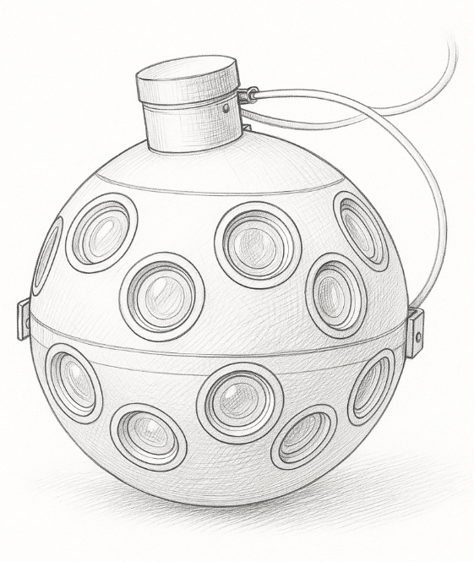
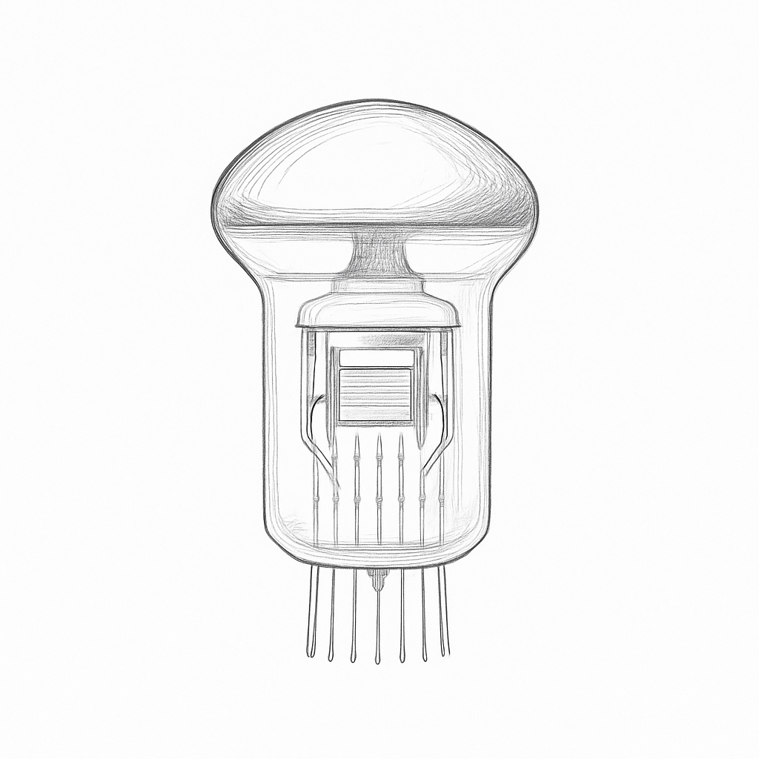
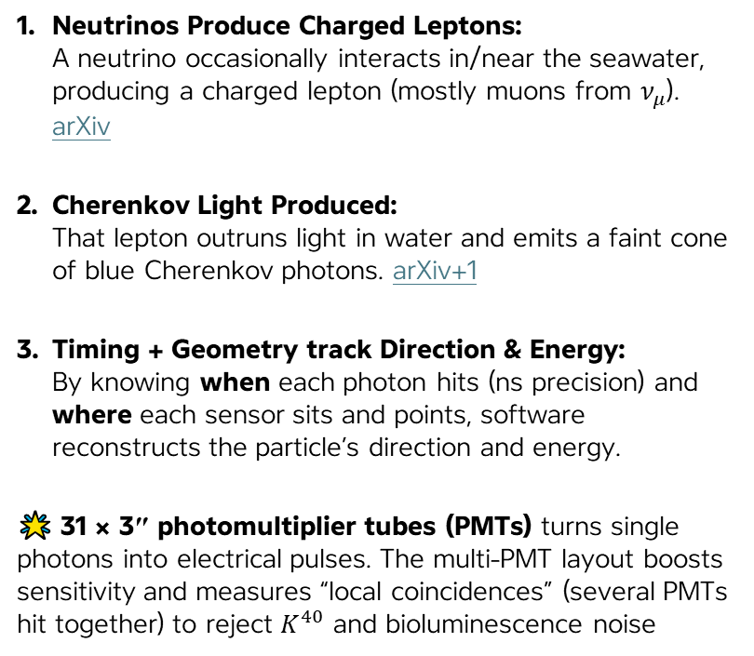
How Are Neutrinos Detected?
Neutrinos Produce Charged Leptons:
A neutrino occasionally interacts in/near the seawater, producing a charged lepton (mostly muons from $ν_{μ}$​). arXiv
Cherenkov Light Produced:
That lepton outruns light in water and emits a faint cone of blue Cherenkov photons. arXiv+1
Timing + Geometry track Direction & Energy:
By knowing when each photon hits (ns precision) and where each sensor sits and points, software reconstructs the particle’s direction and energy.
🌟 31 × 3″ photomultiplier tubes (PMTs) turns single photons into electrical pulses. The multi-PMT layout boosts sensitivity and measures “local coincidences” (several PMTs hit together) to reject $K^{40}$ and bioluminescence noise
Digital Optical Module (DOM)
Photo-Multiplier Tubes (PMT)
Complete Model
Adapted from [KM3NeT 2016]
26. 11. 2025
Exploring Neutrino Oscillations in KM3NeT

Slide 32
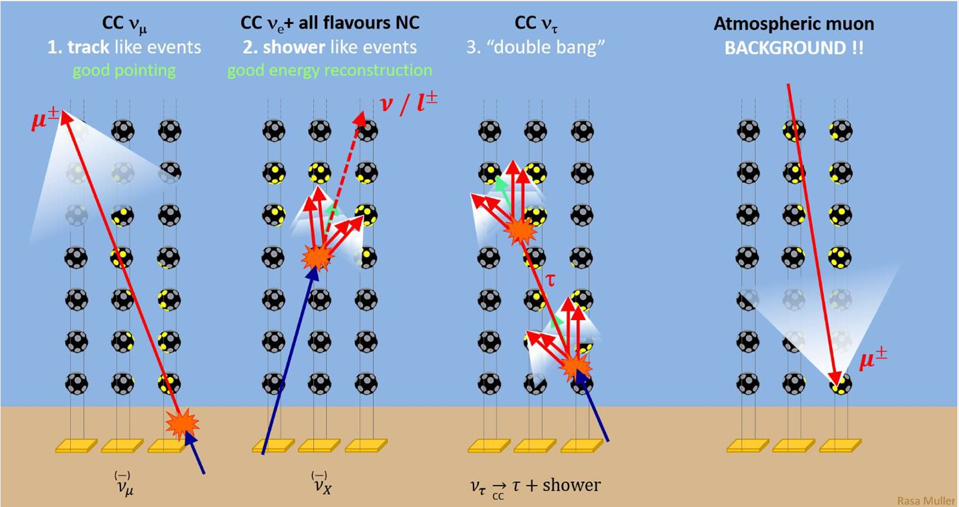
Neutrino Detection Events
Adapted from [Jorge G. 2024]
26. 11. 2025
Exploring Neutrino Oscillations in KM3NeT

Slide 33

Oscillation Probabilities
from [KM3NeT 2016]
26. 11. 2025
Exploring Neutrino Oscillations in KM3NeT

Slide 34

Atmospheric Neutrino Flux
from [KM3NeT 2016]
26. 11. 2025
Exploring Neutrino Oscillations in KM3NeT

Slide 35

Neutrino Event Classification
from [KM3NeT 2016]
26. 11. 2025
Exploring Neutrino Oscillations in KM3NeT

Slide 36

Mixing Angle $θ_{23}$ Significance
from [KM3NeT 2016]
26. 11. 2025
Exploring Neutrino Oscillations in KM3NeT

Slide 37
Broader Implications
26. 11. 2025
Statistical Techniques in KM3NeT

Slide 38




Physics Research Opportunities
Dark Matter
Cosmic Rays
Gamma Ray Burst (GRBs)
Particle Physics Beyond the Standard Model
26. 11. 2025
Exploring Neutrino Oscillations in KM3NeT
Notes:
Particle Physics Image: https://www.google.com/url?sa=i&url=https%3A%2F%2Fwww.energy.gov%2Fscience%2Fdoe-explainsthe-standard-model-particle-physics&psig=AOvVaw1TsKc8iwVDtqzcX-SdcxYx&ust=1763934347766000&source=images&cd=vfe&opi=89978449&ved=0CBgQjhxqFwoTCIjV2dPdhpEDFQAAAAAdAAAAABAI
Gamma Ray Bursts: https://www.google.com/url?sa=i&url=https%3A%2F%2Fwww.space.com%2Fgamma-ray-burst.html&psig=AOvVaw3_AufqafjqfdFS8S-FBf-W&ust=1763934300433000&source=images&cd=vfe&opi=89978449&ved=0CBgQjhxqFwoTCMizwObdhpEDFQAAAAAdAAAAABAE
Cosmic Rays: https://www.google.com/url?sa=i&url=https%3A%2F%2Fnews.uchicago.edu%2Fexplainer%2Fwhat-are-cosmic-rays&psig=AOvVaw28PYDKRBA15K3wloPcH5D3&ust=1763934267445000&source=images&cd=vfe&opi=89978449&ved=0CBgQjhxqFwoTCNimxvzdhpEDFQAAAAAdAAAAABAE
Dark Matter: https://www.google.com/url?sa=i&url=https%3A%2F%2Fscience.nasa.gov%2Fmission%2Froman-space-telescope%2Fdark-matter%2F&psig=AOvVaw0sm7_QD9DEEj9A2YjwKhBP&ust=1763934460711000&source=images&cd=vfe&opi=89978449&ved=0CBgQjhxqFwoTCKD80YjehpEDFQAAAAAdAAAAABAE

Slide 39
References
[1] S. Adrián-Martínez et al. “Letter of intent for KM3NeT 2.0”. In: Journal of Physics G: Nuclear and Particle Physics 43.8 (2016), p. 084001. DOI: 10.1088/0954-3899/43/8/084001. arXiv:1601.07459.
[2] Lukas Hennig. “Tau neutrino identification with Graph Neural Networks in KM3NeT/ORCA”. Master’s thesis. MA thesis. Friedrich-Alexander-Universität Erlangen–Nürnberg (FAU), June2023. URL: https://ecap.nat.fau.de/wp-content/uploads/2023/06/2023-06_LukasHennig_MSc_ORCA_TauID_GNNs.pdf.
[3] Jorge Prado González. An Overview of Machine Learning Techniques in KM3NeT. Presentation, Neutrino Physics and Machine Learning, ETH Zurich. Accessed 23 Nov 2025. 2024. URL: https://indico.phys.ethz.ch/event/113/contributions/843/attachments/517/1112/jprado_NPML_presentation_june2024.pdf.
[4] Mark Thomson. Handout 11: Neutrino Oscillations. Lecture Handout, Part III Particle Physics, University of Cambridge. Accessed 23 Nov 2025. 2009. URL: https://www.hep.phy.cam.ac.uk/~thomson/lectures/partIIIparticles/Handout11_2009.pdf.
[5] Mark Thomson. Modern Particle Physics. Cambridge, UK: Cambridge University Press, 2013.ISBN: 9781107034266. URL: https://www.cambridge.org/highereducation/books/modern-particle-physics/CDFEBC9AE513DA60AA12DE015181A948.
[6] Steffen Hallmann. “Sensitivity to atmospheric tau-neutrino appearance and all-flavour search for neutrinos from the Fermi Bubbles with the deep-sea telescopes KM3NeT/ORCA andANTARES”. en. Available under CC BY-NC-SA 4.0. Doctoral thesis. Erlangen, Germany: Friedrich-Alexander-Universität Erlangen-Nürnberg, Feb. 2021. URL: https://open.fau.de/handle/openfau/15749.
26. 11. 2025
Exploring Neutrino Oscillations in KM3NeT

Slide 40
Thank You!
26. 11. 2025
Exploring Neutrino Oscillations in KM3NeT

